Slide 2


Hashing Based Techniques for building scalable solutions.
May 20, 2020

Slide 3
Topics we will cover
What is hashing?
Scope of the scale at which the most popular sites operate
Hashing Techniques most often used to resolve the scalability bottlenecks:
Consistent Hashing
Bloom Filter
Count-min Sketch

Slide 4
Section 1
What is Hashing?

Slide 5

What is Hashing?
Hashing is a process of converting a given input into a fixed sized output, also called ‘hashing value’ or ‘hash’.
Hashing is used in:
password verification
verification of file data integrity and
speeding up of information retrieval by employing them in data structures such as Hash Tables and Bloom Filters.
A hashing function implements a mathematical algorithm to perform the conversion process.
The hashing function guarantees that it will always return the same output for a given input, no matter how many times it called with this input.
For instance, given a hash function h1
and input ‘Axl Rose’, h1(‘Axl Rose’) = 1234 no matter
how many times it is invoked.
Also, for given input ‘Saul Hudson’, h1(‘Saul Hudson’) =
5678 no matter how many times it is invoked.

Slide 6
What is Hashing?
Hashing ideally guarantees a one way conversion, i.e., it precludes the possibility of regenerating the original input from the output hash.
A good hashing algorithm ensures minimal hash collisions.
The input to a hash function can be of any particular data type including primitives, variable length strings and streams.
Since the output values are of the fixed size, they are often best represented as numeric primitives.

Slide 7
Section 2
Scope of the scale at which the most popular sites operate

Slide 8
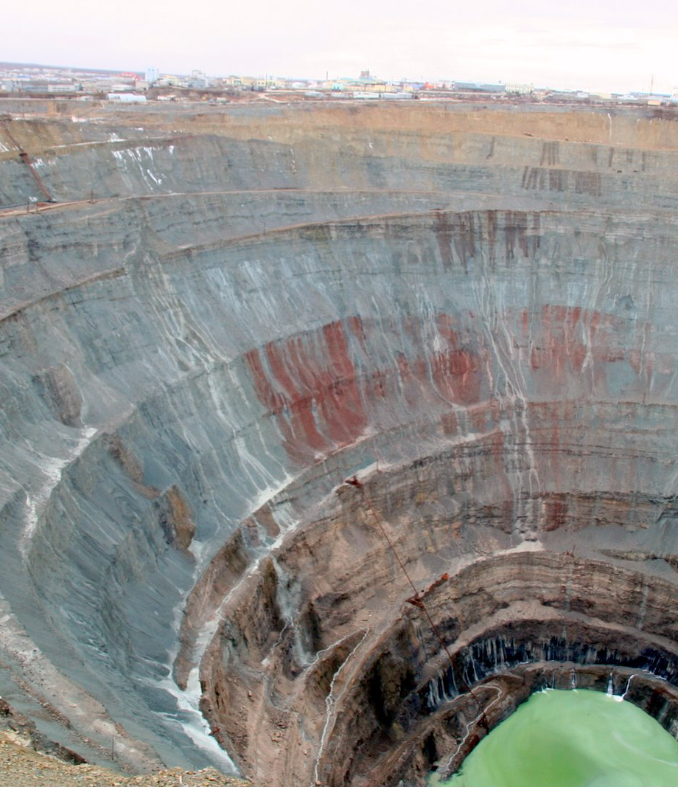
Scope of the scale at which the most popular sites operate
Scalable Solutions require more performant solutions.
They need to employ certain best practices and techniques to handle the data and user traffic.
They need to rely on horizontal scaling while ensuring a near 1:1 relationship between increased load and increase in capacity needed to handle it.
Netflix
167 million total users
12.6% of downstream internet traffic worldwide
140 million hours of videos watched everyday
Translates to ~ 150 gigabytes/second of data.
References:
https://www.businessofapps.com/data/netflix-statistics/
https://variety.com/2019/digital/news/netflix-loses-title-top-downstream-bandwidth-application-1203330313/

Slide 9
Scope of the scale at which the most popular sites operate (Cont’d)
Google
5.5 billion searches per day or 65K search queries per day according to Internet Live Stats
Source - https://ardorseo.com/blog/how-many-google-searches-per-day/
900k - 1 million search servers running in 2011
Source - https://www.datacenterknowledge.com/archives/2011/08/01/report-google-uses-about-900000-servers
Youtube
35% of global mobile internet traffic
Source - https://www.fiercevideo.com/video/youtube-accounts-for-35-worldwide-mobile-internet-traffic-sandvine-says
500 hours of video uploaded to Youtube every minute
Source - https://www.brandwatch.com/blog/youtube-stats/
Facebook
4 petabytes of data per day
Source - https://kinsta.com/blog/facebook-statistics/
1.73 billion daily active users
Source - https://zephoria.com/top-15-valuable-facebook-statistics/
Source - https://research.fb.com/blog/2014/10/facebook-s-top-open-data-problems/
Instagram
500 million daily active users
4.2 billion likes per day
100 million photos and videos uploaded per day
Source - https://www.omnicoreagency.com/instagram-statistics/

Slide 10
Section 3
Consistent Hashing

Slide 11

Consistent Hashing
Consistent hashing solves the problem of dynamic addition and removal of nodes from a distributed system. It places all available nodes in a fixed size circular data structure where the node indexes are calculated by using pre-defined hashing functions.
Used to allocate keys uniformly across all available nodes.
It provides a consistent way of re-assigning only some of the data to other nodes in case of a node failure.
Ensures that in general, only n/m keys need to be reassigned on addition or removal of nodes, where
n = number of keys
m = number of available nodes.
Used to implement distribute databases, distributed caches and distributed hash tables.
Well known implementation - Apache Cassandra Ring.

Slide 12
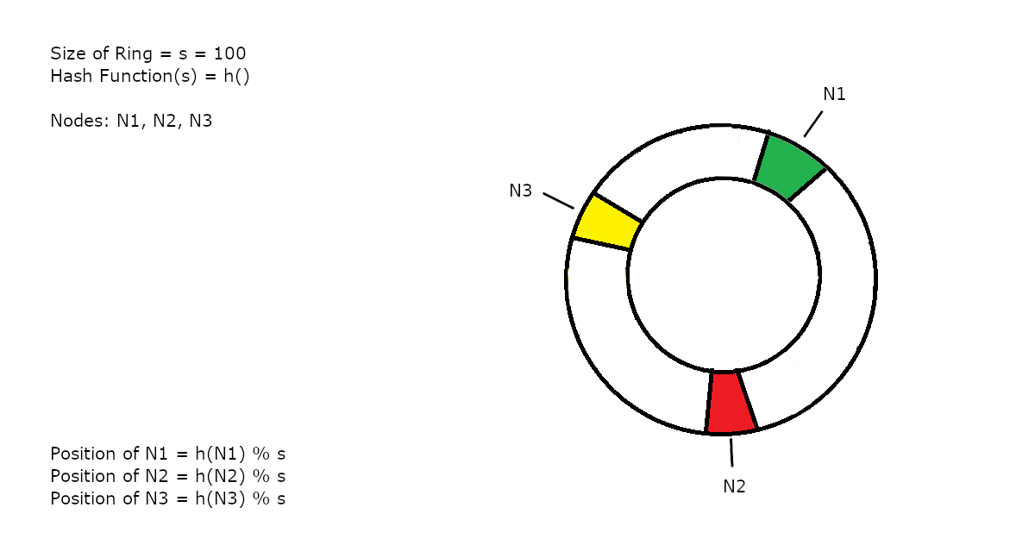
Consistent Hashing

Slide 13
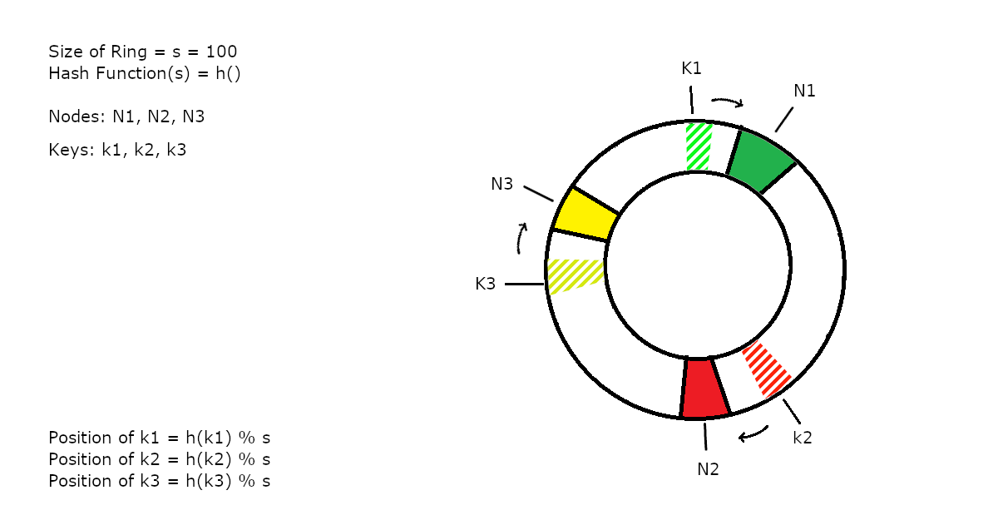
Consistent Hashing

Slide 14
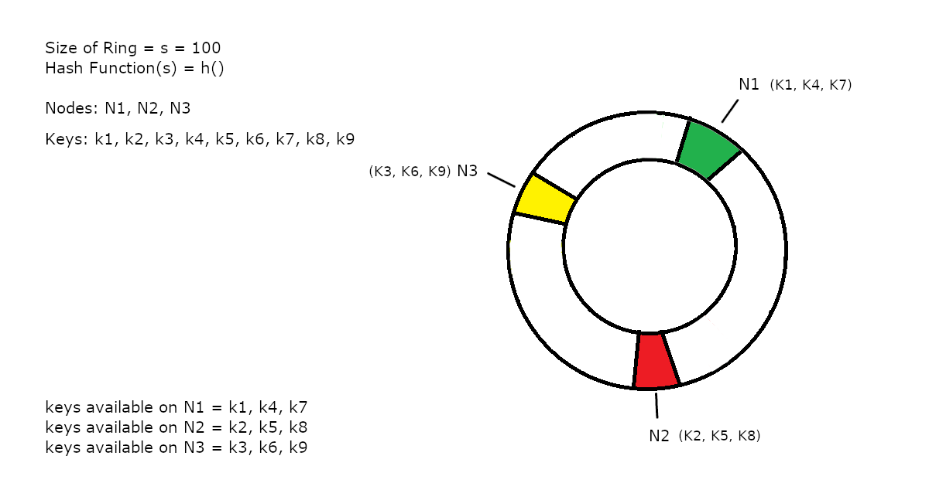
Consistent Hashing

Slide 15
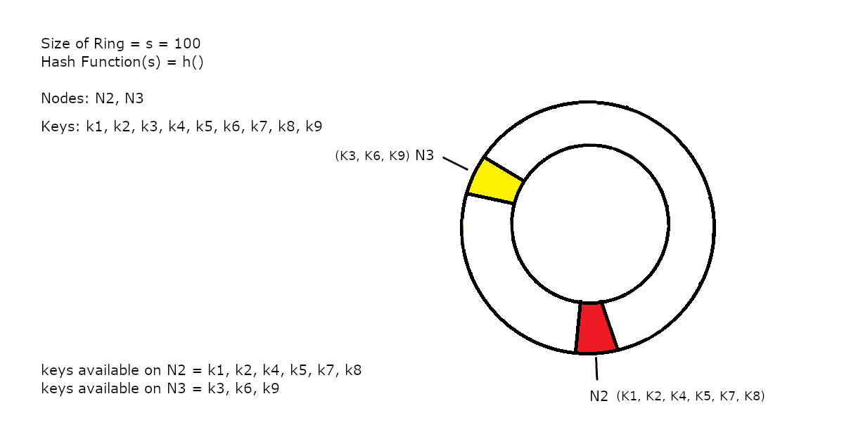
Consistent Hashing

Slide 16
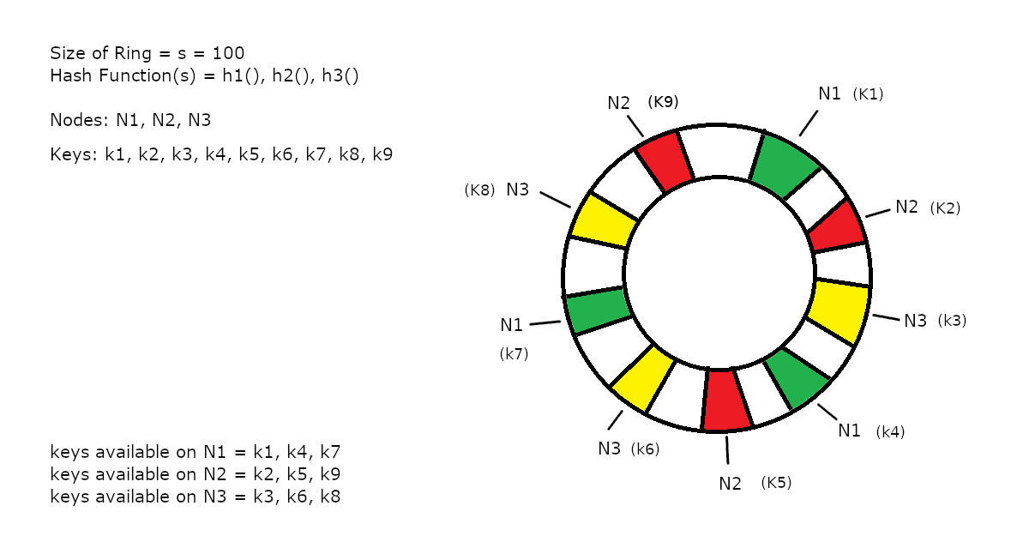
Consistent Hashing

Slide 17
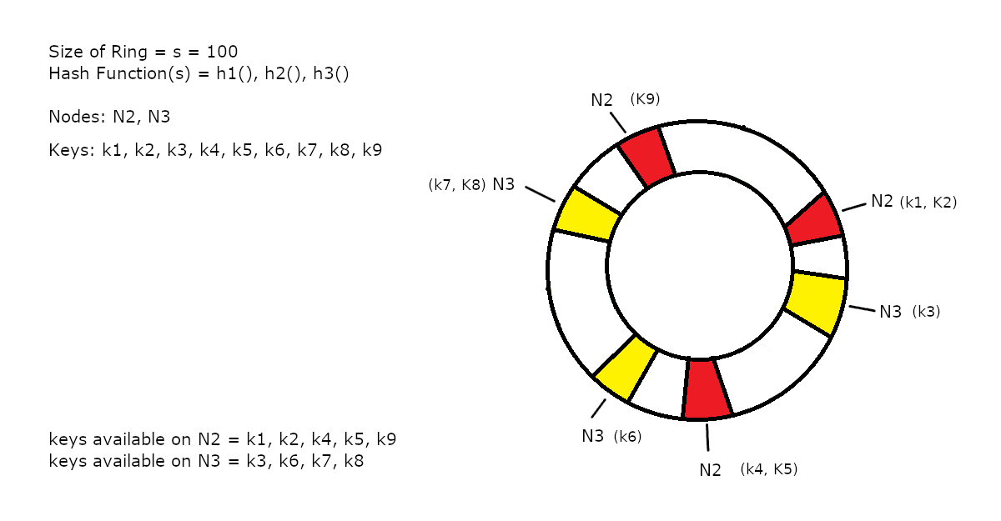
Consistent Hashing
More even distribution of keys due to more available hash functions

Slide 18
Section 4
Bloom Filter

Slide 19

Bloom Filter
Probabilistic data structure with sublinear space complexity.
Use cases:
Quickly identify duplicate user ids during sign up process
Malicious site identification
Spell checker
Can return false positives but no false negatives.
The precision can be improved by
increasing the number and quality of hash functions
Increasing the size of the backing array
Used by: Google Chrome, Apache Cassandra, eBay, Netflix

Slide 20
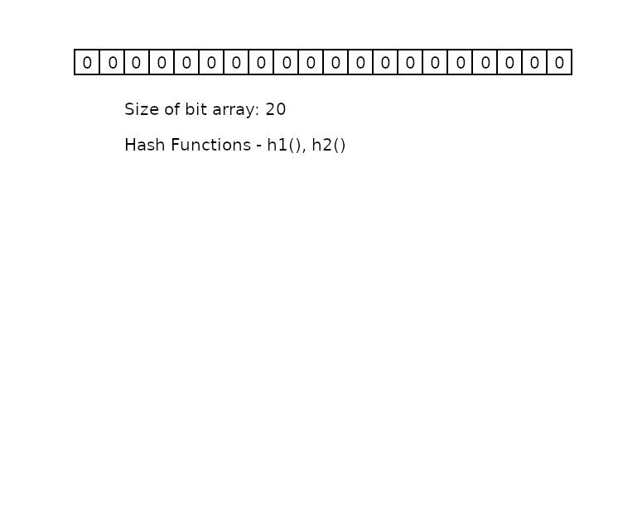
Bloom Filter

Slide 21
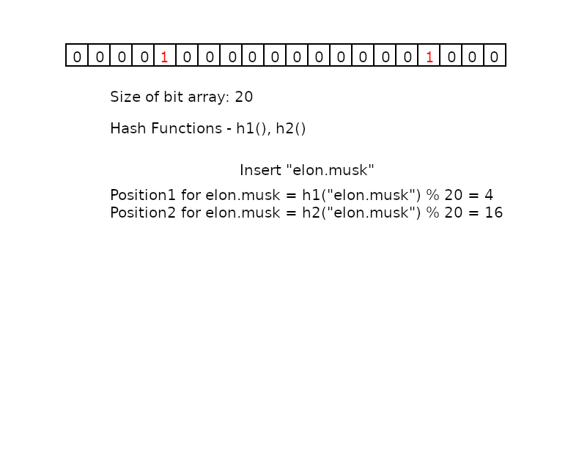
Bloom Filter

Slide 22
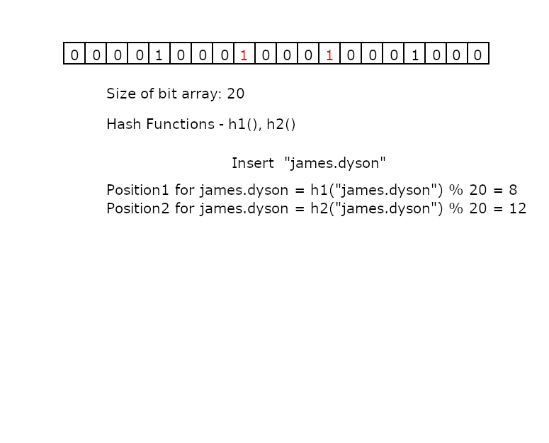
Bloom Filter

Slide 23
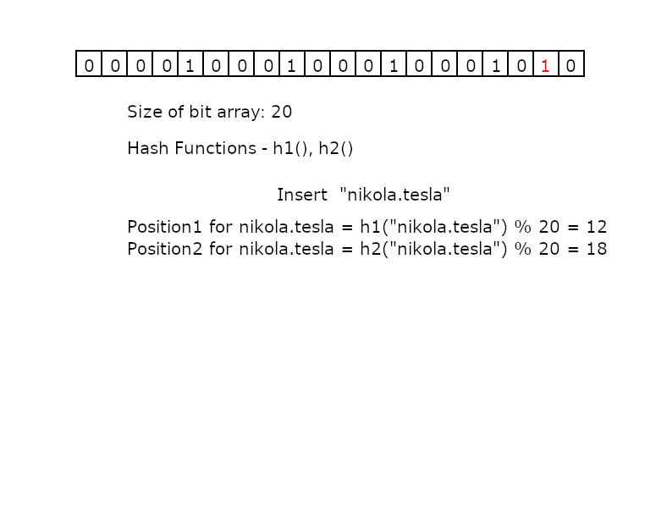
Bloom Filter

Slide 24
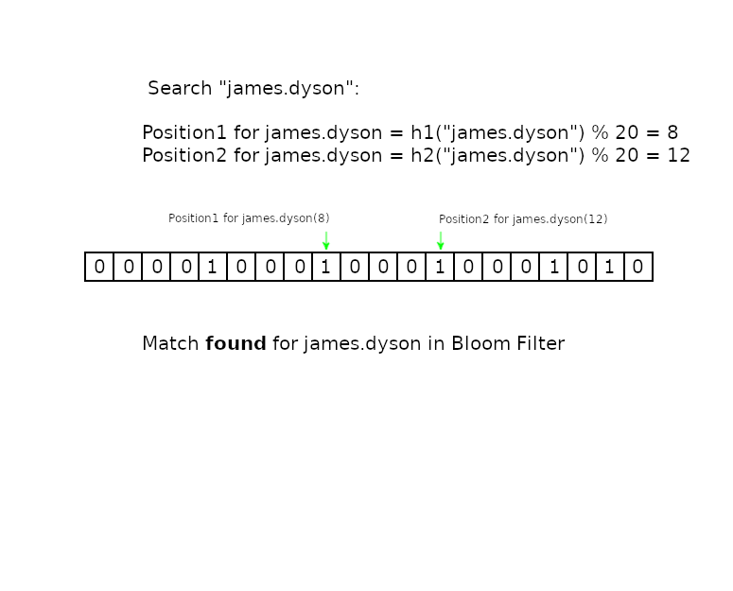
Bloom Filter

Slide 25
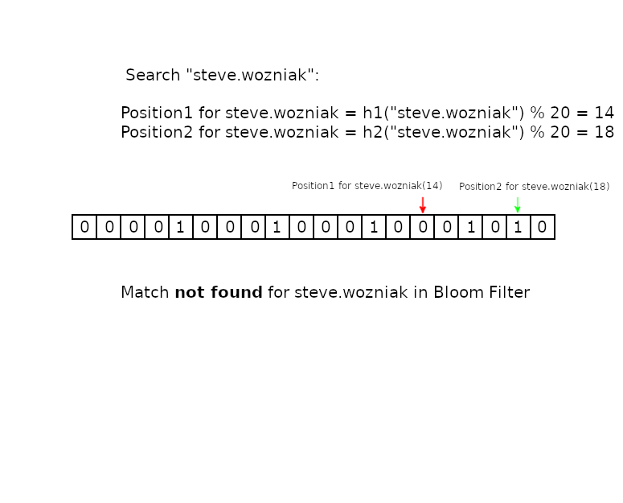
Bloom Filter

Slide 26
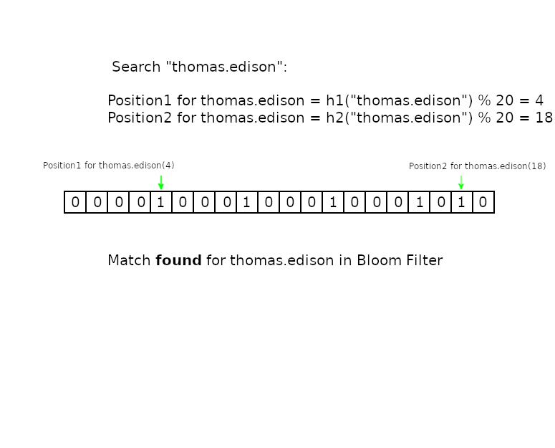
Bloom Filter
False positive returned due to hash collisions.

Slide 27
Section 4
Count-min Sketch

Slide 28

Count-min sketch
Count-min sketch is a probabilistic data structure used to track frequencies in a streaming data. Like Bloom Filter, it prioritises sub-linear space usage over accuracy on hash collisions.
Used in internet traffic analysis, analysis of logs of large scale systems, Natural Language Processing and implementation of cache eviction policies.
It is an implementation of a counting Bloom Filter that keeps track of the number of occurrences of the provided input.
Like the regular Bloom filter, it has a sub-linear space complexity.
Never returns lesser result than the actual count.
Can return higher count in case of hash collisions
Precision can be improved by
increasing the number and quality of hash functions
Increasing the column width of the backing store.

Slide 29
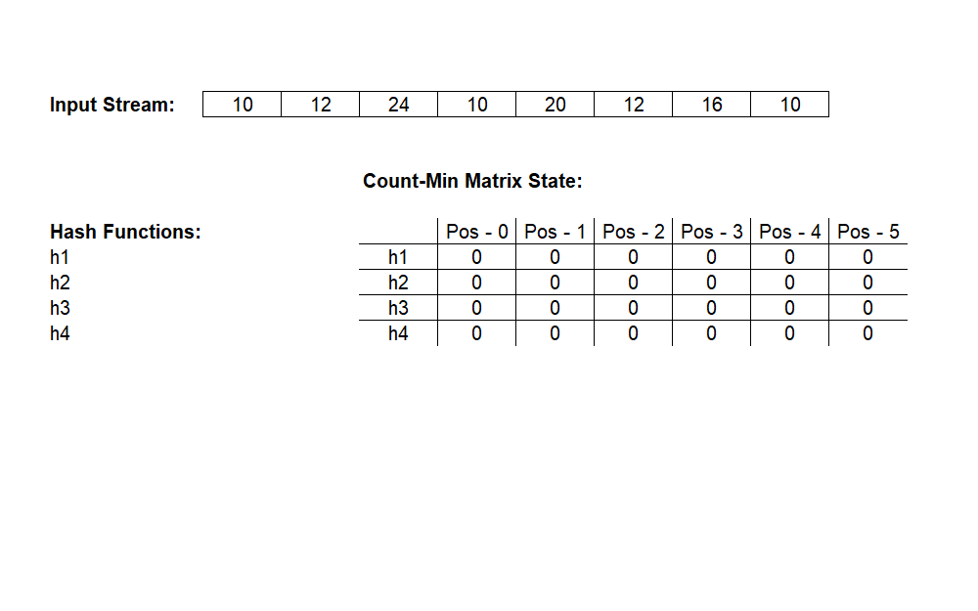
Count-min Sketch
Subheads set in sentence case

Slide 30
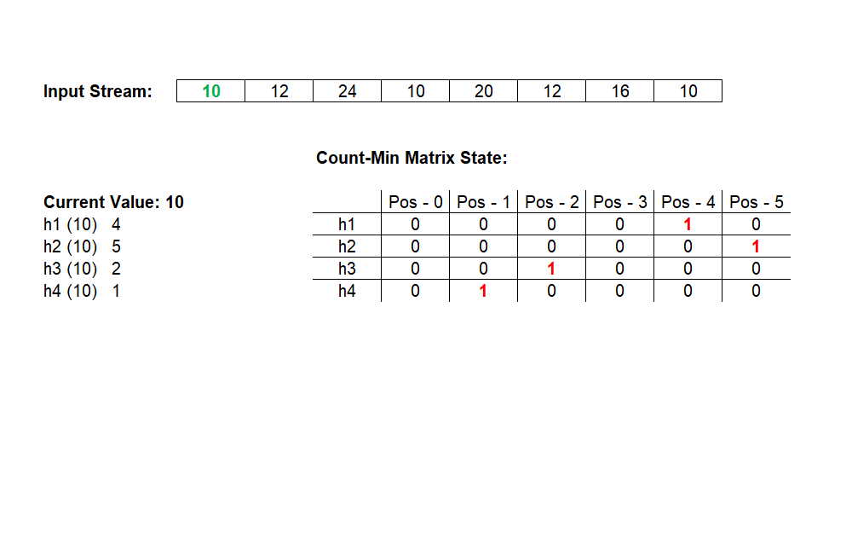
Count-min Sketch

Slide 31
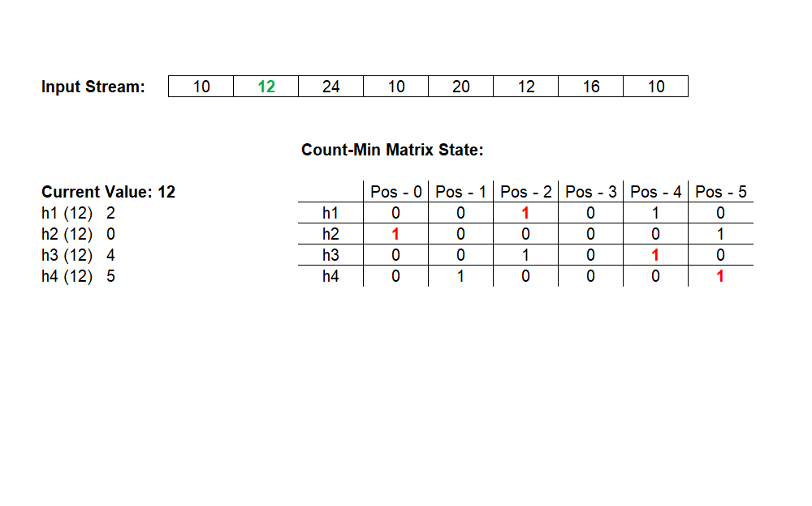
Count-min Sketch

Slide 32
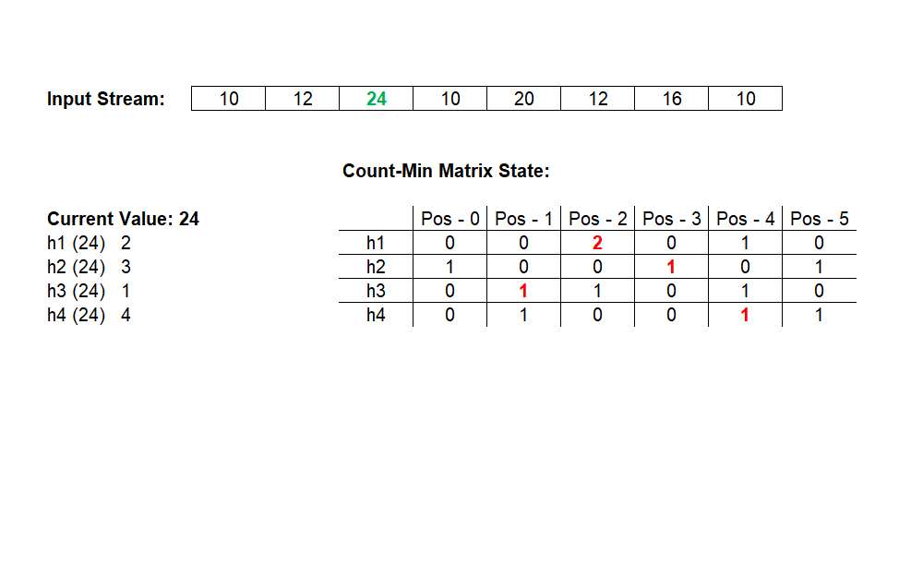
Count-min Sketch

Slide 33
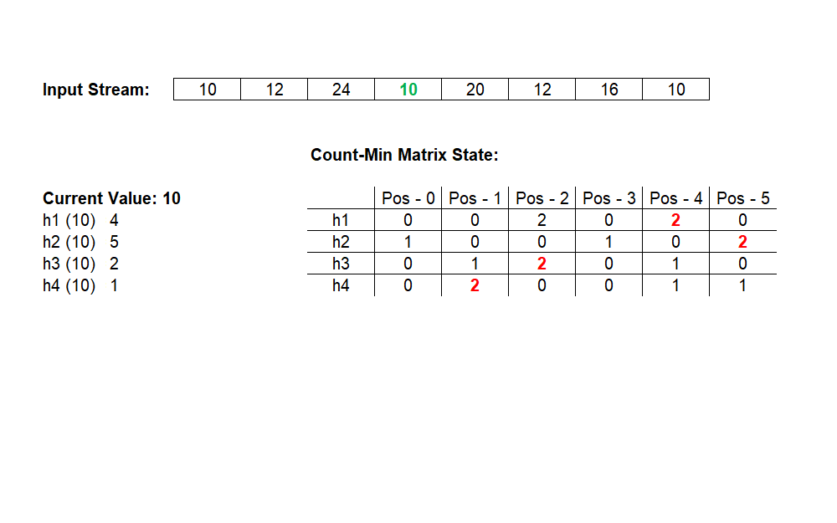
Count-min Sketch

Slide 34
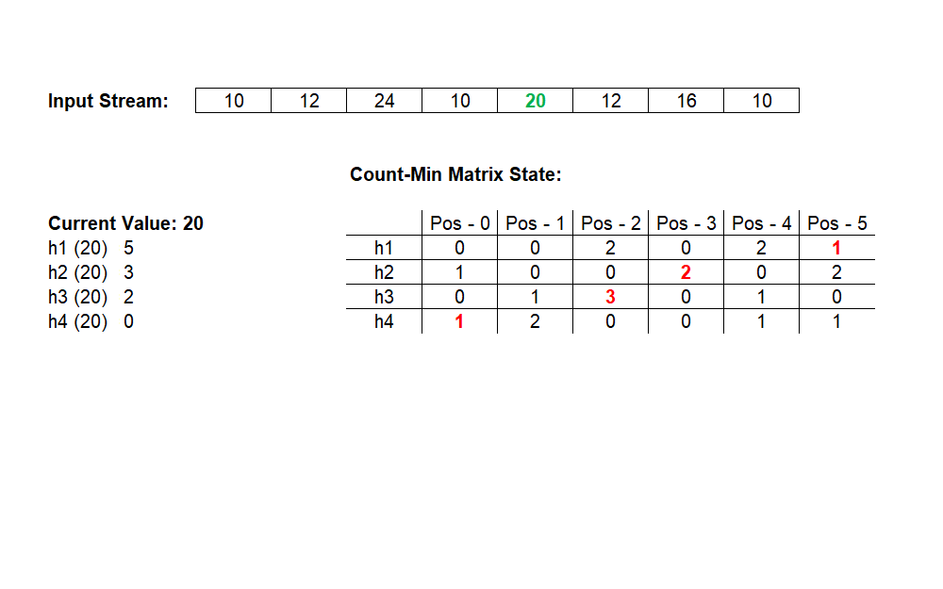
Count-min Sketch

Slide 35
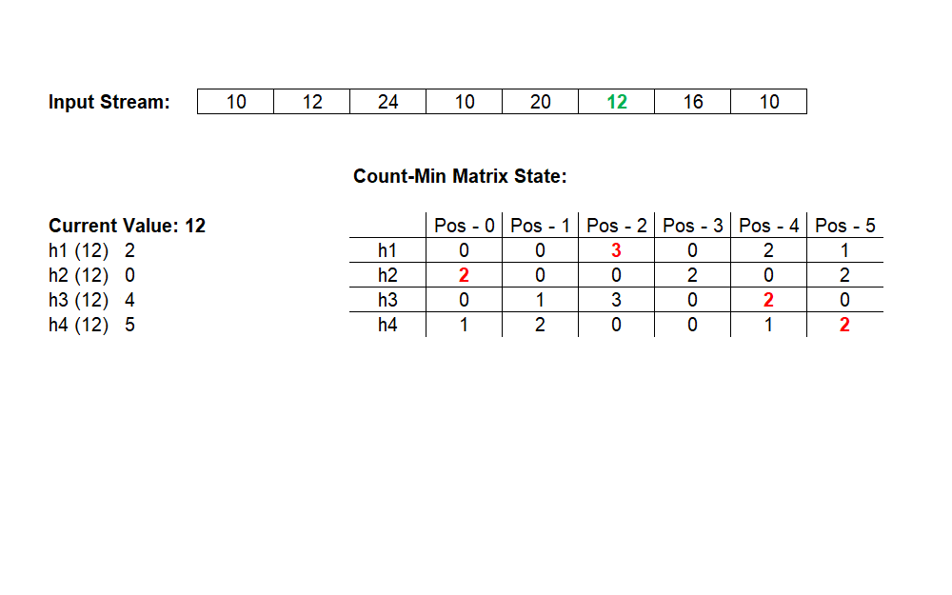
Count-min Sketch

Slide 36
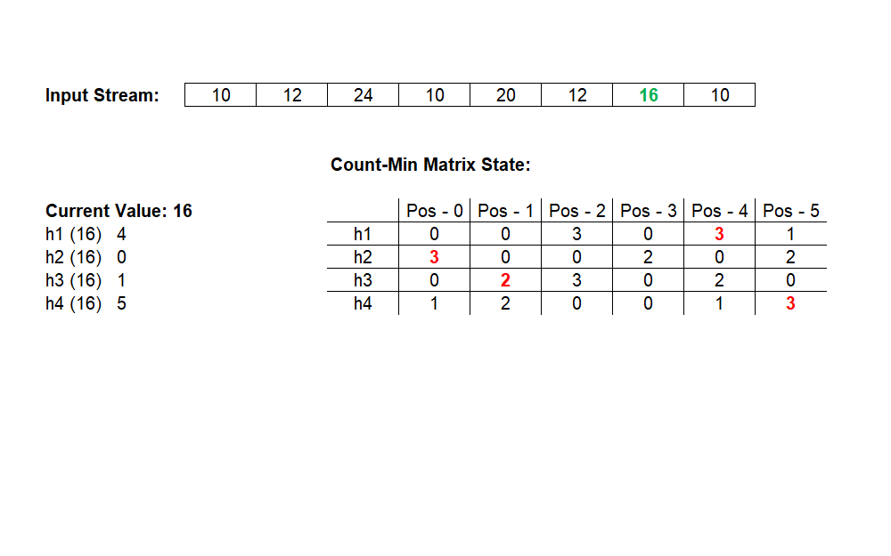
Count-min Sketch

Slide 37
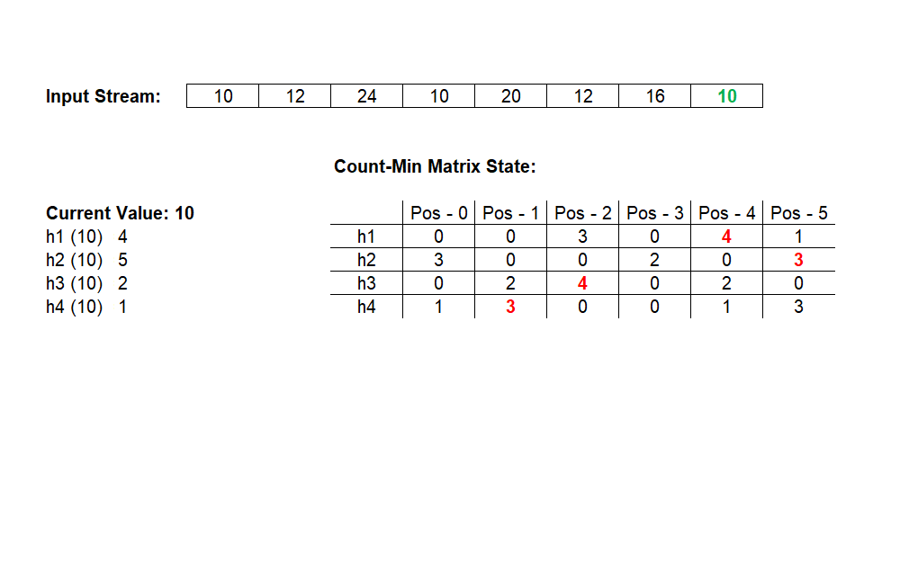
Count-min Sketch

Slide 38
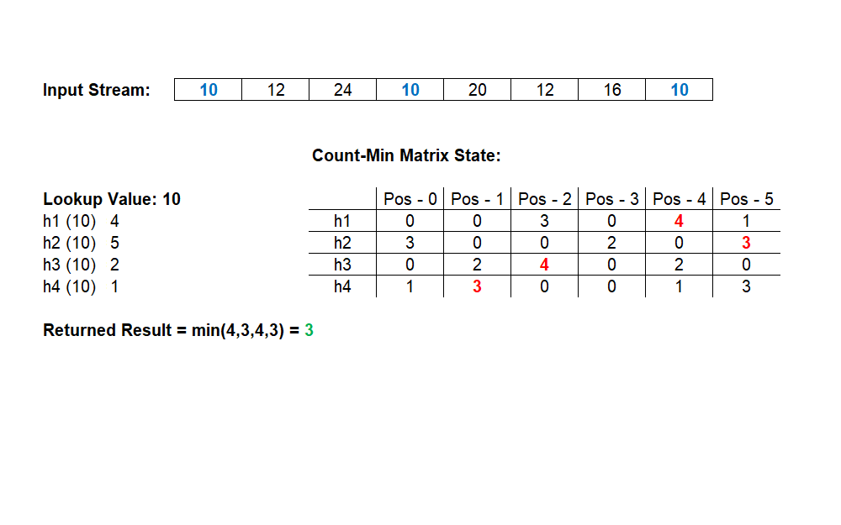
Count-min Sketch

Slide 39
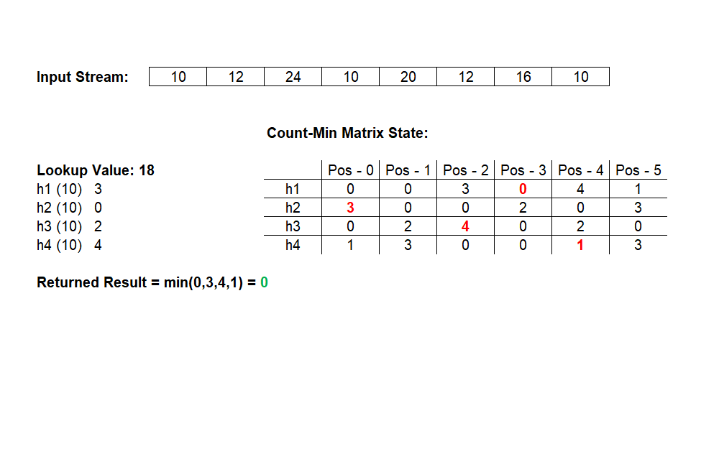
Count-min Sketch

Slide 40
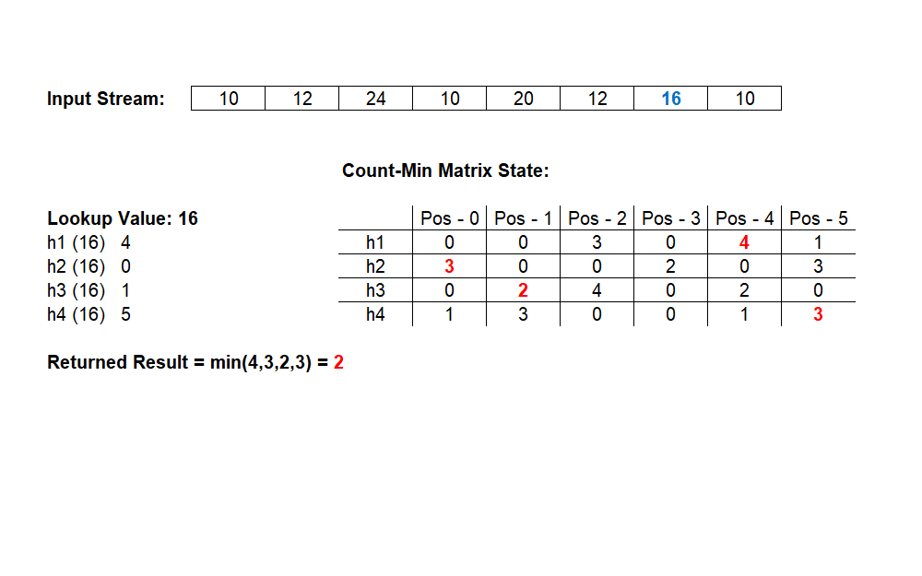
Count-min Sketch
Higher result returned due to hash collisions.

